Slide 1
Bad Movie Reviews
COEN 353 - Neil Nguyen

Slide 2
Problem Significance
Movies are met with countless perfect reviews upon release
The reviews are very short and tell nothing about the movie
Found in commercials, magazines, article headlines, etc.
How can you tell if a review is reliable or not?

Slide 3
Problem Challenges
Movie reviews are subjective
Difficult to put a pinpoint on what makes a review “dishonest”
Useless reviews =/= Fake reviews

Slide 4
Current Literature - 2 Different Cases
“Amazon Hits Chinese Sellers With Crackdown on Fake Reviews” - Bloomberg
Amazon used to encourage “freebies” for reviews to increase internet traffic
Products had countless dishonest reviews to boost it and countless dishonest reviews to drag down competitors
Amazon is too large to support this behavior now
“Cracks down” on many Chinese products, good or bad
“Remembering David Manning, Sony’s Fictional Film Critic” - MentalFloss
Sony Director of Creative Advertising created a fake movie critic that positively reviewed every Sony movie
Established film critics’ opinions were valued

Slide 5
Current Literature - Possible Solutions
“Complete Guide to Identify Fake Reviews On Amazon” - geekflare
Fake reviews can easily be bought online
Fake reviewing is a side-job for some reviewers
Strategies to flag fake reviews:
Generic tone/Dead words
Short review length
Perfect/Imperfect scores
Fake reviews detection website
Broken English
Time stamps
Reviewer’s history
Similar reviews

Slide 6
My Proposed Solution
Provide a validity score of a review based on certain criterias
Users are expected to consider validity scores of reviews when reading them

Slide 7
Experiment - Step 0: Understanding the Dataset
Millions of online movie reviews from the early 2000s (up to October 2012) of Amazon
Relevant Parameters:
Score: score given by reviewer between 1-5
Helpfulness: ratio of users that voted the review as “helpful”
Text: the explanation of the review
Note: I only worked with the first 100000 reviews

Slide 8
Experiment - Step 1: Flagging
Start by filtering out reviews that are “potentially dishonest”
What are the discrete criterias for this?
Contains dead words (“awesome”, “good”, “bad”, etc.)
Short length (< 20 words)
Have a low or nonexistent helpfulness score (< 0.5) as provided by the dataset
Have a perfect/imperfect score (1 or 5)

Slide 9
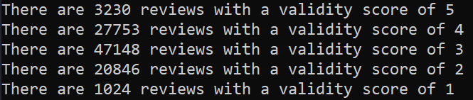
Experiment - Step 2: Scoring
A review has an initial validity score of 5
The range of validity scores is [1,5]
For every dishonest criteria flagged, subtract 1 from the score
Each criteria is weighed equally

Slide 10
Experiment - Step 3: Criterias Eye Test
Dead words: weak criteria
Too broad
Sets too high of an expectation for reviewer’s vocabulary
Short reviews: medium criteria
Inconsistent
Unhelpful reviews: strong criteria
Most unhelpful reviews weren’t movie related at all
Some legitimate-sounding reviews were potentially unfairly deemed unhelpful
Most unhelpful reviews did not have a helpfulness score at all
Perfect/Imperfect reviews: weakest criteria
Score range too small
5’s and 1’s are reasonable scores

Slide 11
Experiment - Step 4: Validity Eye Test
Validity 5 Score:
Mostly strong reviews
Some reviews are able to coincidentally sneak by every criteria check
Validity 4 Score:
Lots of reviews with either a few dead words or no helpfulness votes
Still generally strong reviews
Validity 3 Score:
Largest amount of reviews
You start to see the weak reviews here
Strong reviews are held down here by no helpfulness votes
Validity 2 Score:
Mostly weak reviews
Some strong reviews here that managed to tick off exactly 3 criteria checks
Validity 1 Score:
Mostly weak reviews

Slide 12
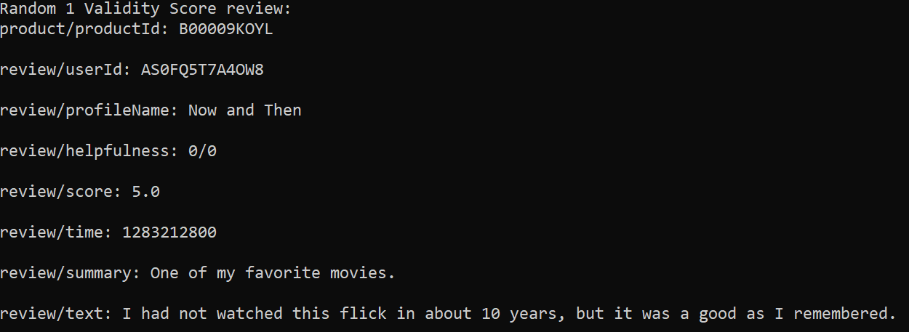
Results - A correct score example
Non-existent helpfulness votes
Short review
Dead use of word “good”
Perfect score
Every criteria hit and applies

Slide 13
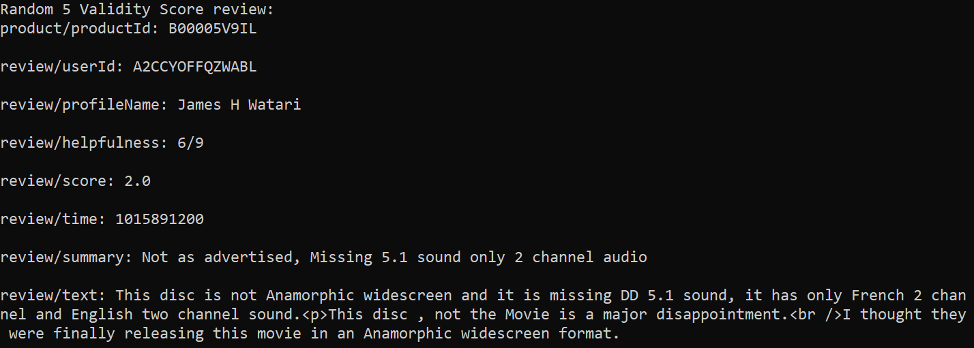
Results - An incorrect score example
Helpfulness voters incorrectly voted based on “product quality” instead of “movie quality”
Just passed short criteria check
Gave a “normal” score
Coincidentally no dead words

Slide 14
Results - Overall
Validity scores have potential
Criterias might be too discrete
Discrete criterias have potential to weed out bot reviews
Not necessarily judge low quality human reviews
Not enough criterias
Time
User reputation
Movies are very subjective
Maybe this strategy could be better applied in another field (apps, products, etc.)

Slide 15
Thank you! Questions?

